Slide 1

Student Helper Program
Budget Manager, Plagiarism Detector, and Time Manager
Presented by: Anas Ahmed 2023114 Ayaan Azam 2023596 Raahim Ali 2023585

Slide 2

Program Overview
Comprehensive Tool
Budgeting, plagiarism detection, and task management
Target Audience
Designed for student resource and time management

Slide 3
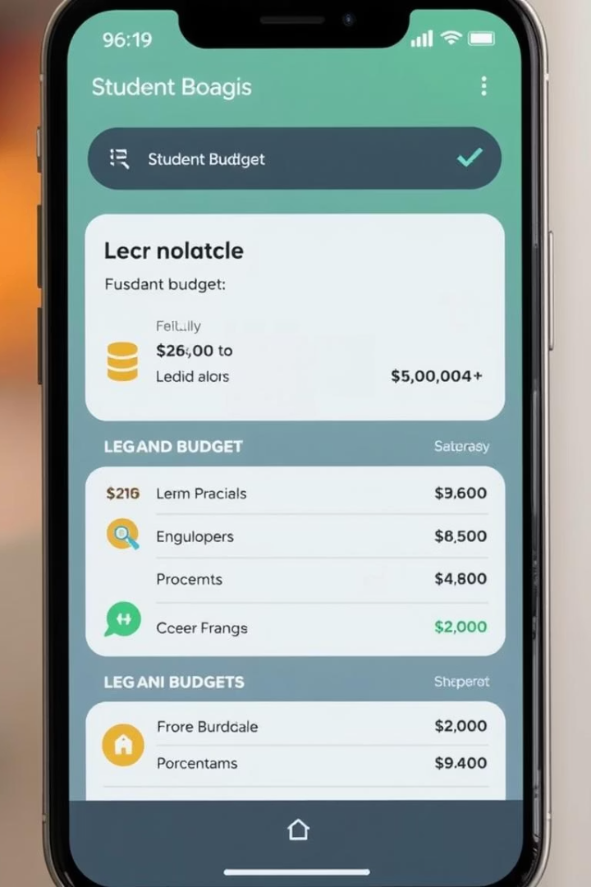
Budget Manager Functionality
Allocation
Distributes budget based on user priorities
Preset & Custom Options
Flexible budgeting suited to diverse needs

Slide 4
Budget Manager Features
Input Data
History Tracking
Enter total budget and define priorities
Review accessed priorities over time
Divide budget daily or weekly

Slide 5
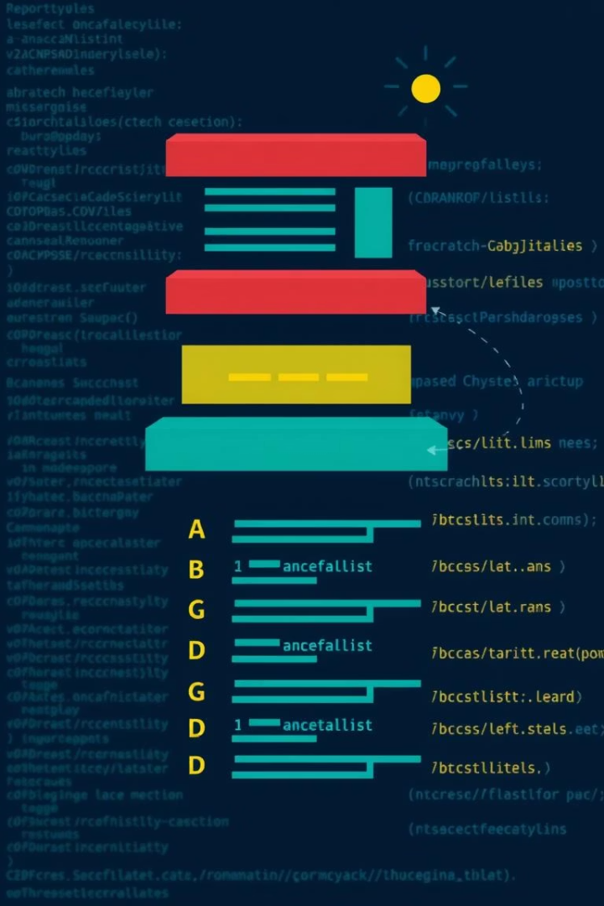
Budget Manager Implementation
Data Structures
Stack for history tracking
Linked List for priority management
Class Design
Priority class for calculations
BudgetManager class for managing priorities

Slide 6
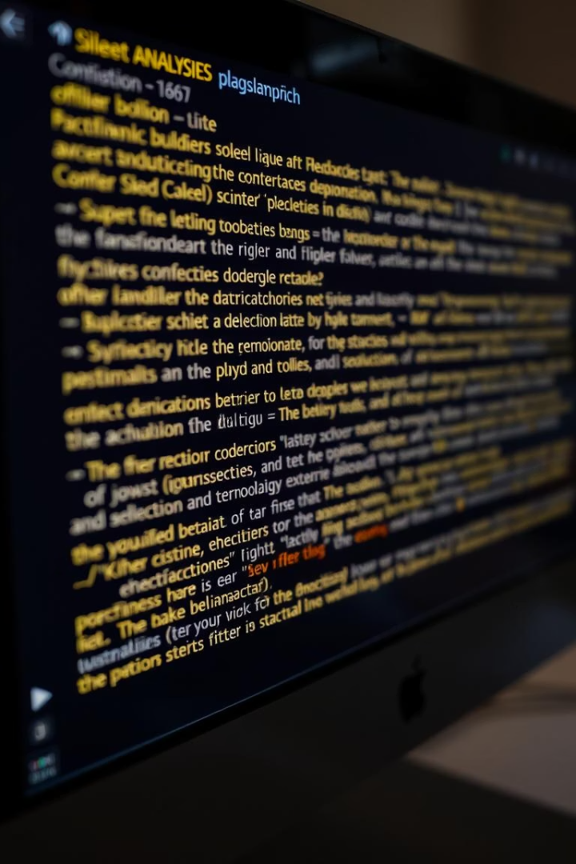
Plagiarism Detector Purpose
Detects text similarities and plagiarized content
Produces detailed similarity reports

Slide 7

Plagiarism Detector Features
1
Text Tokenization
2
Similarity Comparison
Generates n-grams for matching
Compares source and target texts
3
Report Generation
Details matches and percentages

Slide 8
Plagiarism Analysis & Reports
Analysis Methods
Report Components
Jaccard similarity on n-grams
Timestamp of analysis
Text complexity via Flesch Reading Ease
Source and target document details
Plagiarism percentage

Slide 9
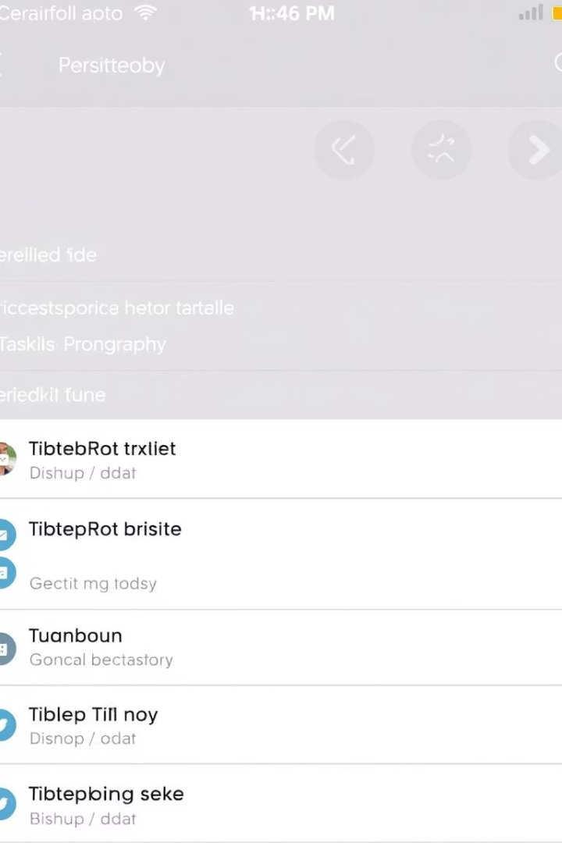
Time Manager Overview
Task Prioritization
Dependencies
Organize by urgency and importance
Manage task relationships and order
Deadline Tracking
Keep deadlines visible and manageable

Slide 10
Time Manager Features
Task Operations
Visualizations
Add, remove, defer tasks
Graphical view of task dependencies
View active and completed tasks

Slide 11
Time Manager Implementation
Priority Queue: Efficiently manages active, high-priority tasks for quick access.
Linked List: Tracks completed and pending tasks for dynamic update handling.
Scheduler Class: Coordinates task timing and deadlines effectively.
Graph Class: Visualizes and manages task dependencies and order relations.

Slide 12
Conclusion
Integrated Solution: Combines budgeting, plagiarism detection, and time management seamlessly.
Enhanced Productivity: Helps students optimize resources and deadlines effectively.
User-Focused Design: Tailored features to meet diverse student needs and learning styles.
Future Potential: Scalable platform supporting academic success and efficient workload handling.

Slide 13
Thank You!!

